Slide 1


The Future of Humankind: Giant Steps in Outer Space

Slide 2
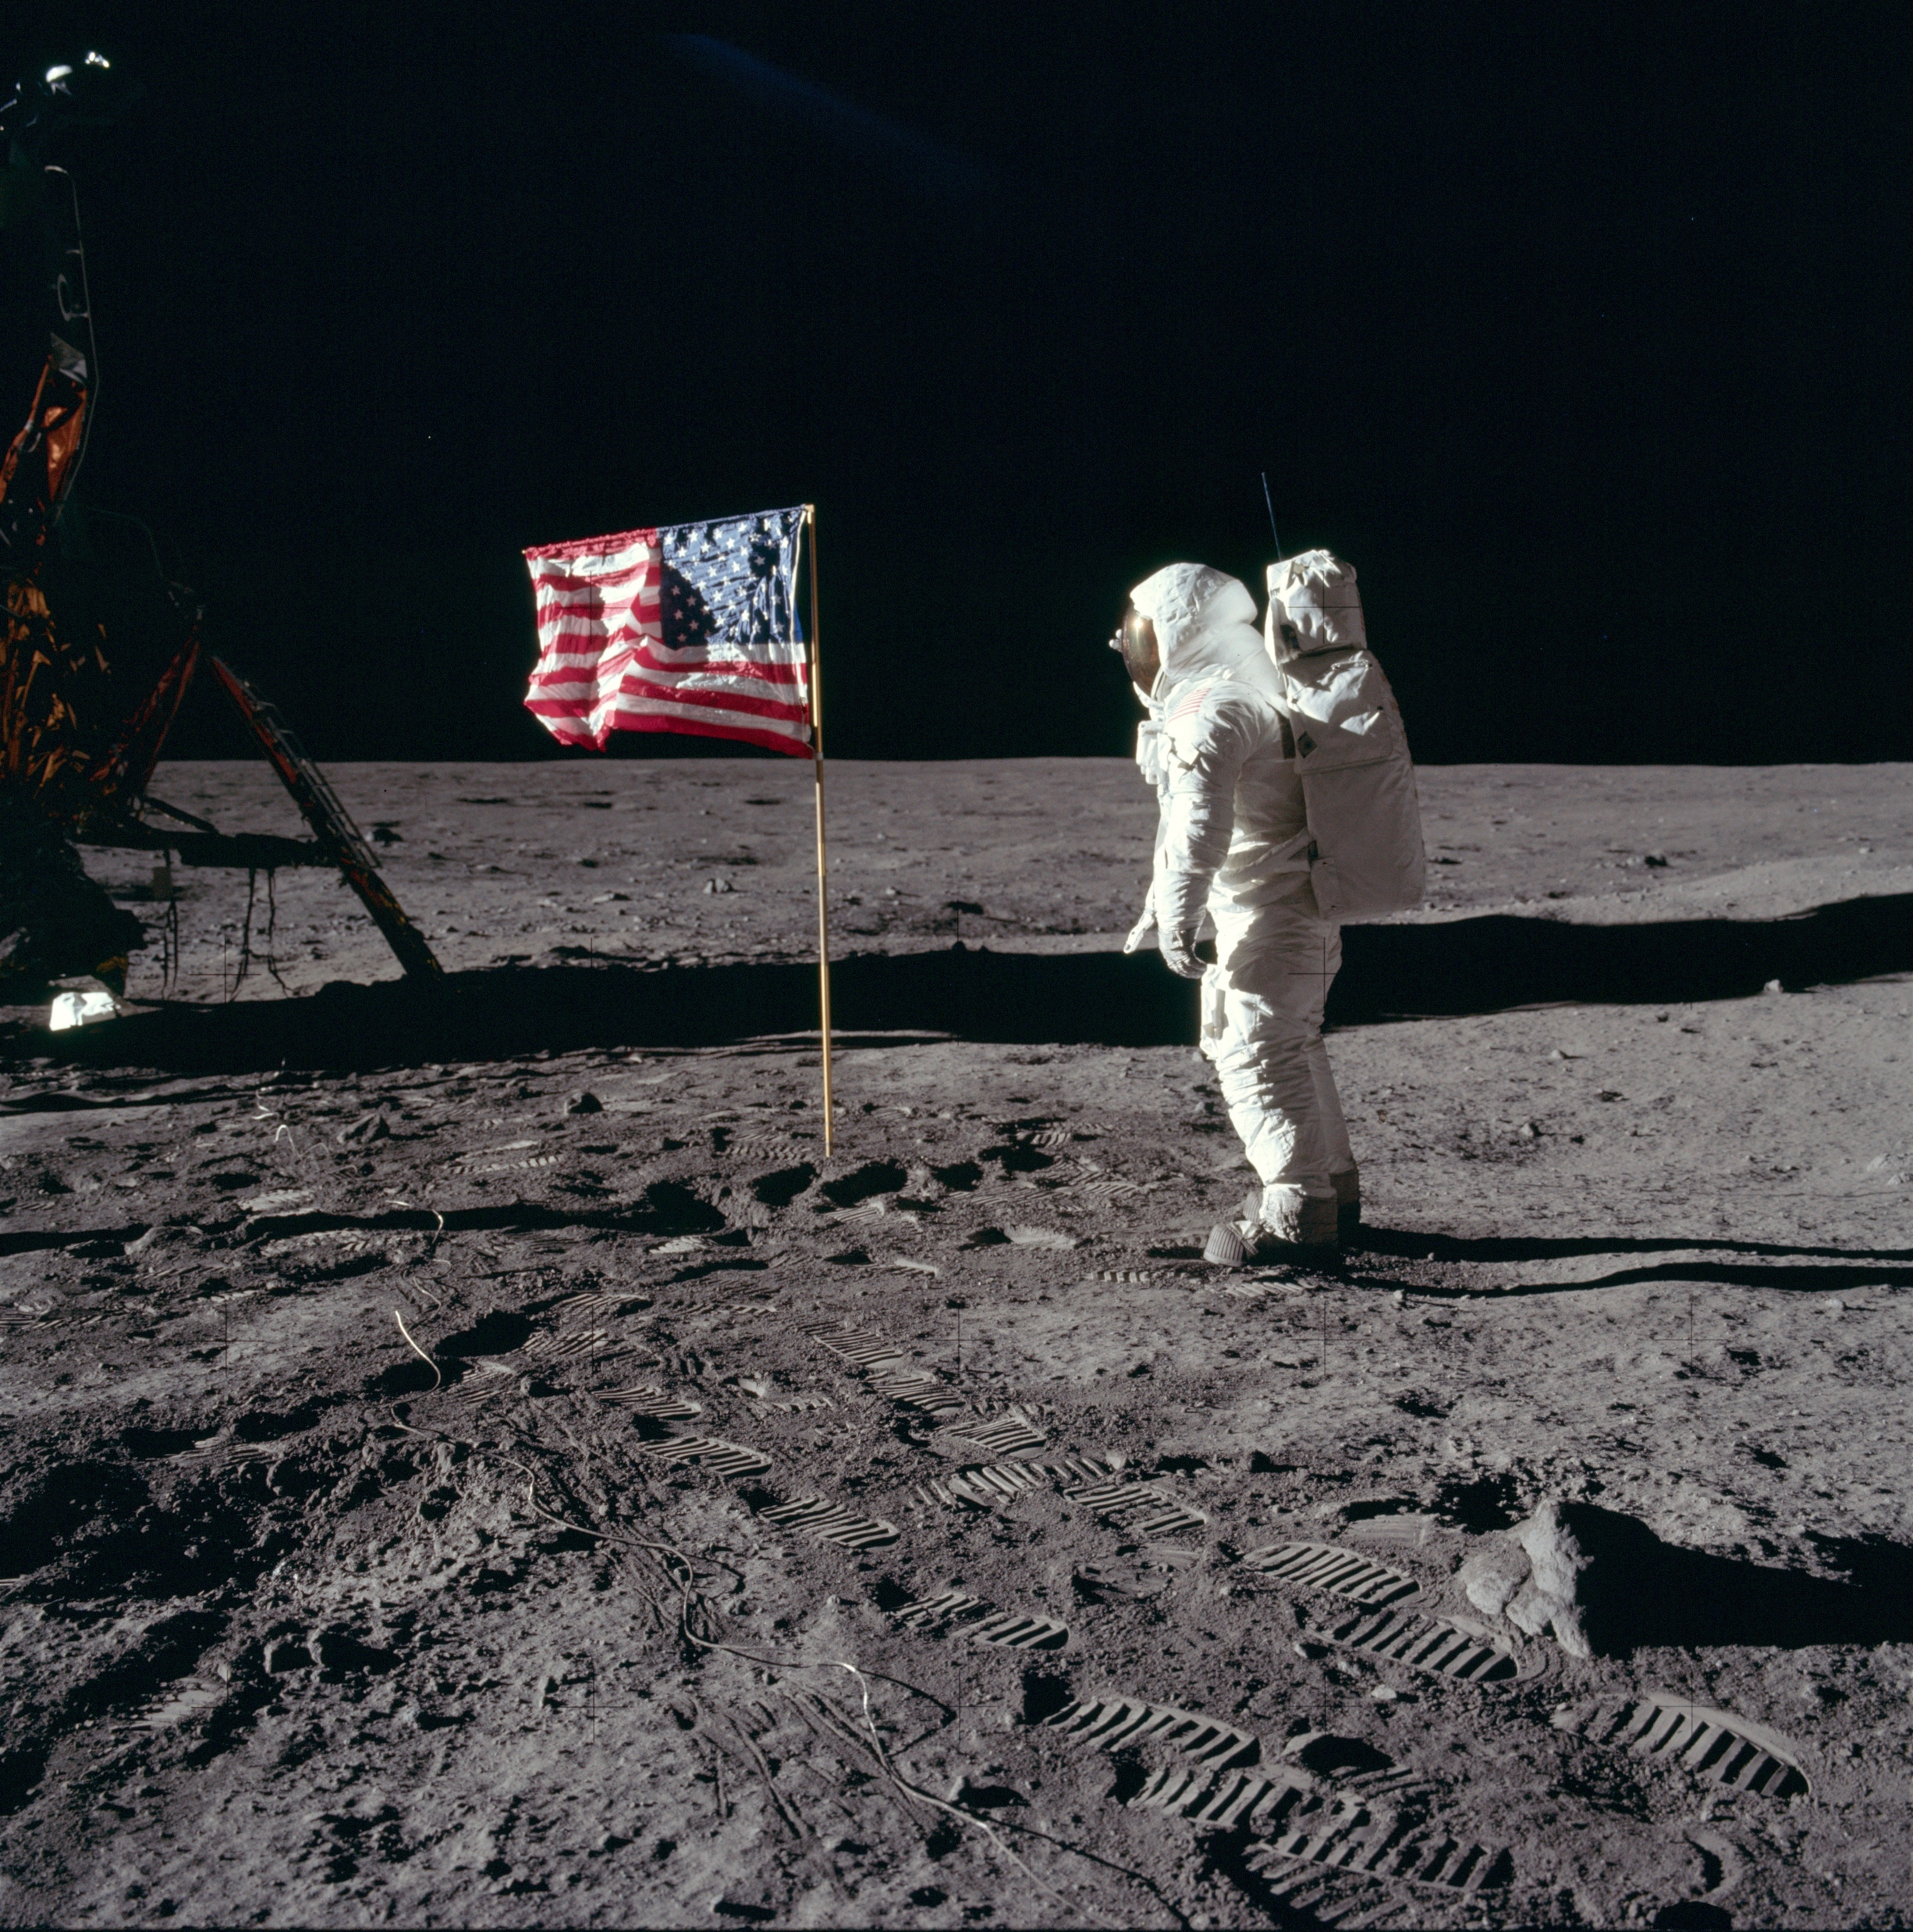
20 July 1969

Slide 3
Notes:
Me talking live.

Slide 4
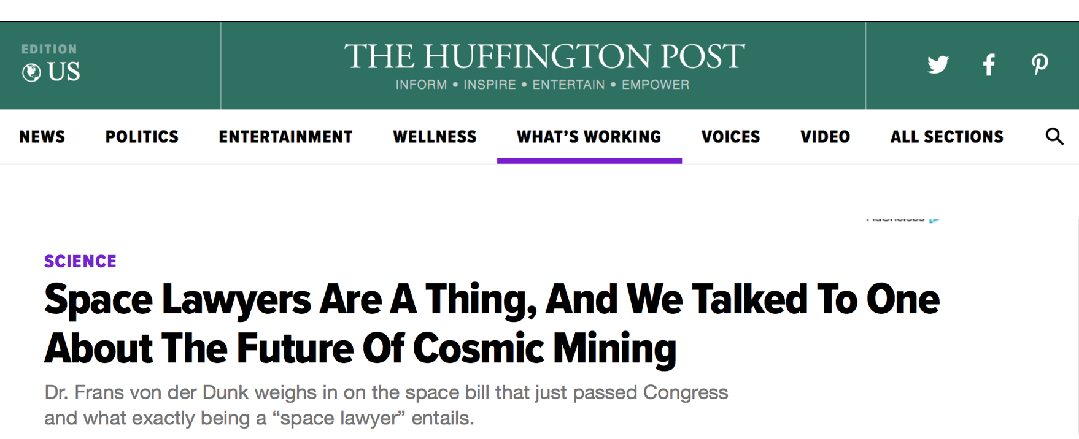
A ‘space lawyer’…?

Slide 5

Director at Black Holes B.V.

Slide 6











Consulting on space law and space policy

Slide 7

Professor at University of Nebraska-Lincoln

Slide 8

Teaching (and researching) space law

Slide 9
20 July 1969
“A small step for man, a giant leap for mankind.”

Slide 10
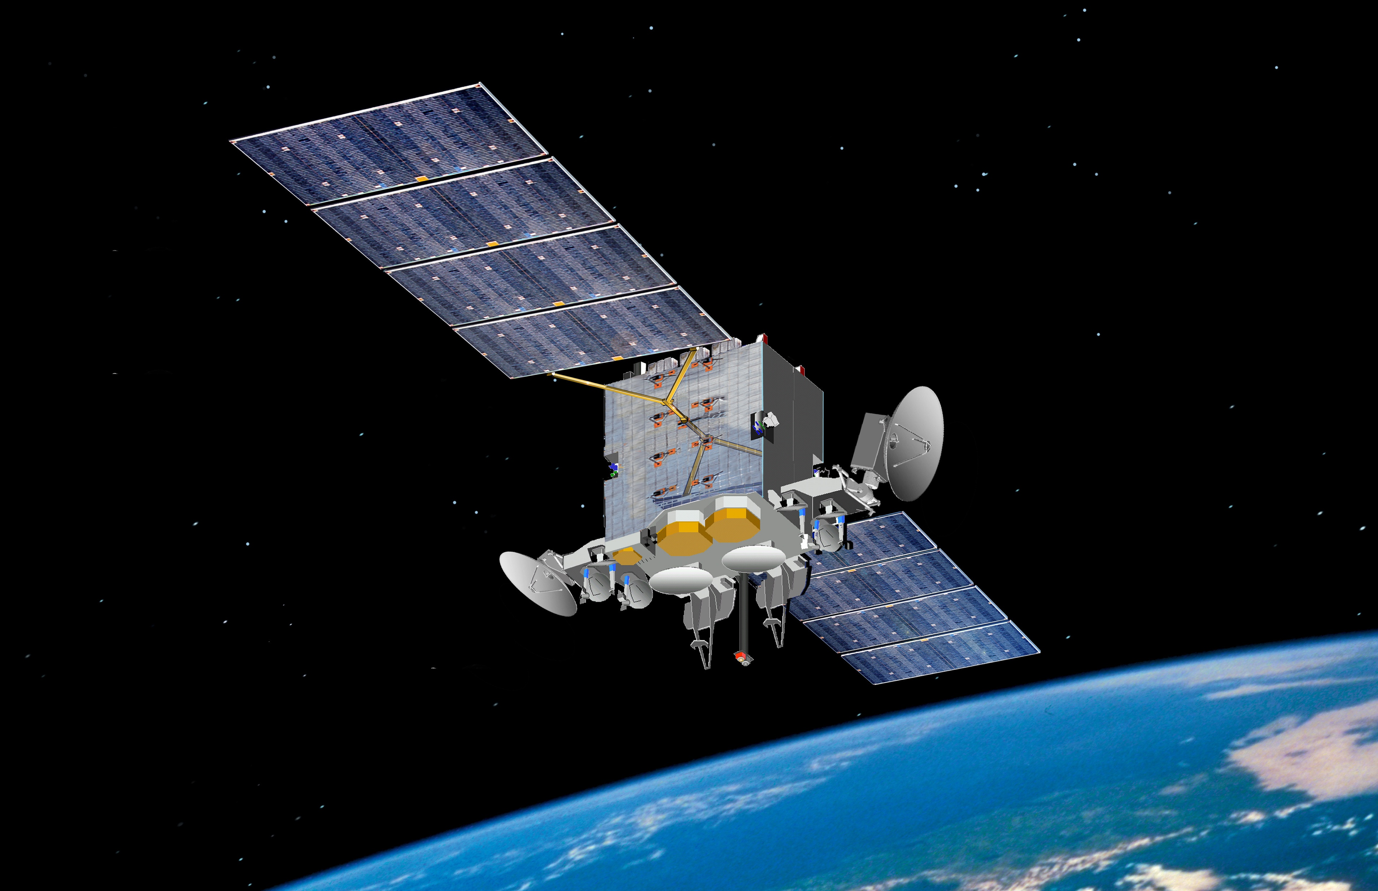
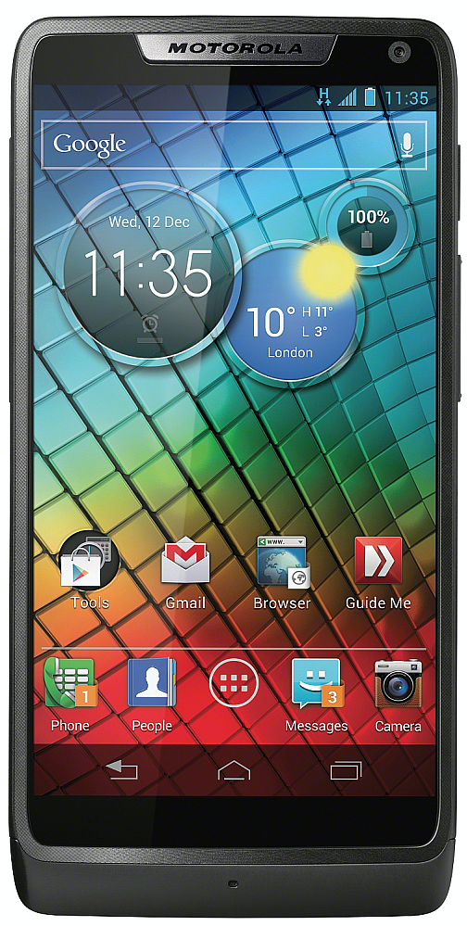
Satellite communications

Slide 11
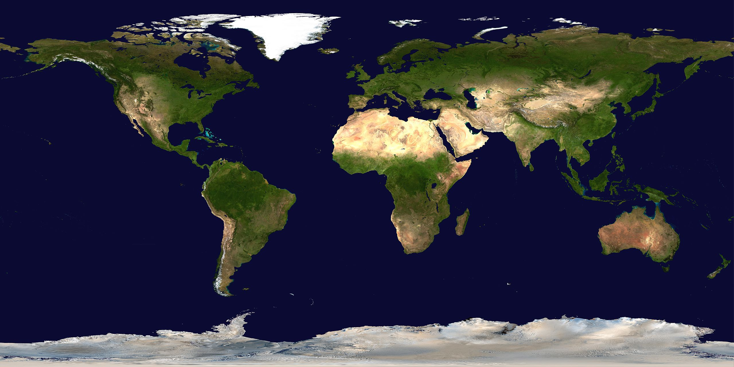
Satellite remote sensing

Slide 12

Satellite navigation

Slide 13

Space tourism

Slide 14

Space mining

Slide 15
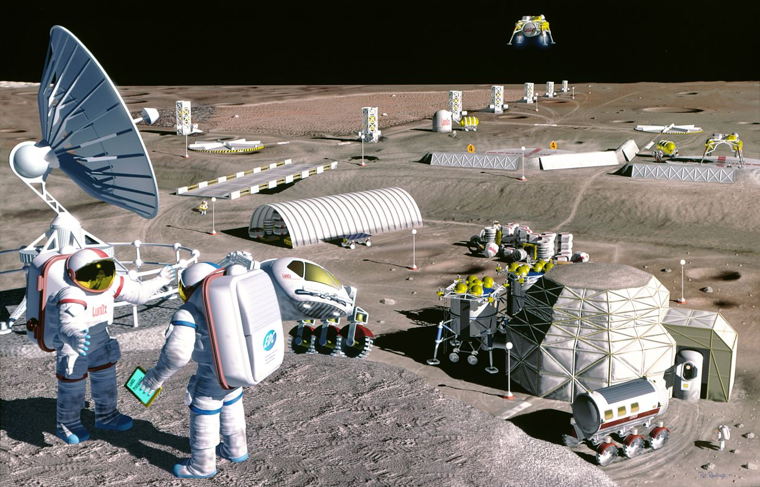
Space ‘colonization’

Slide 16
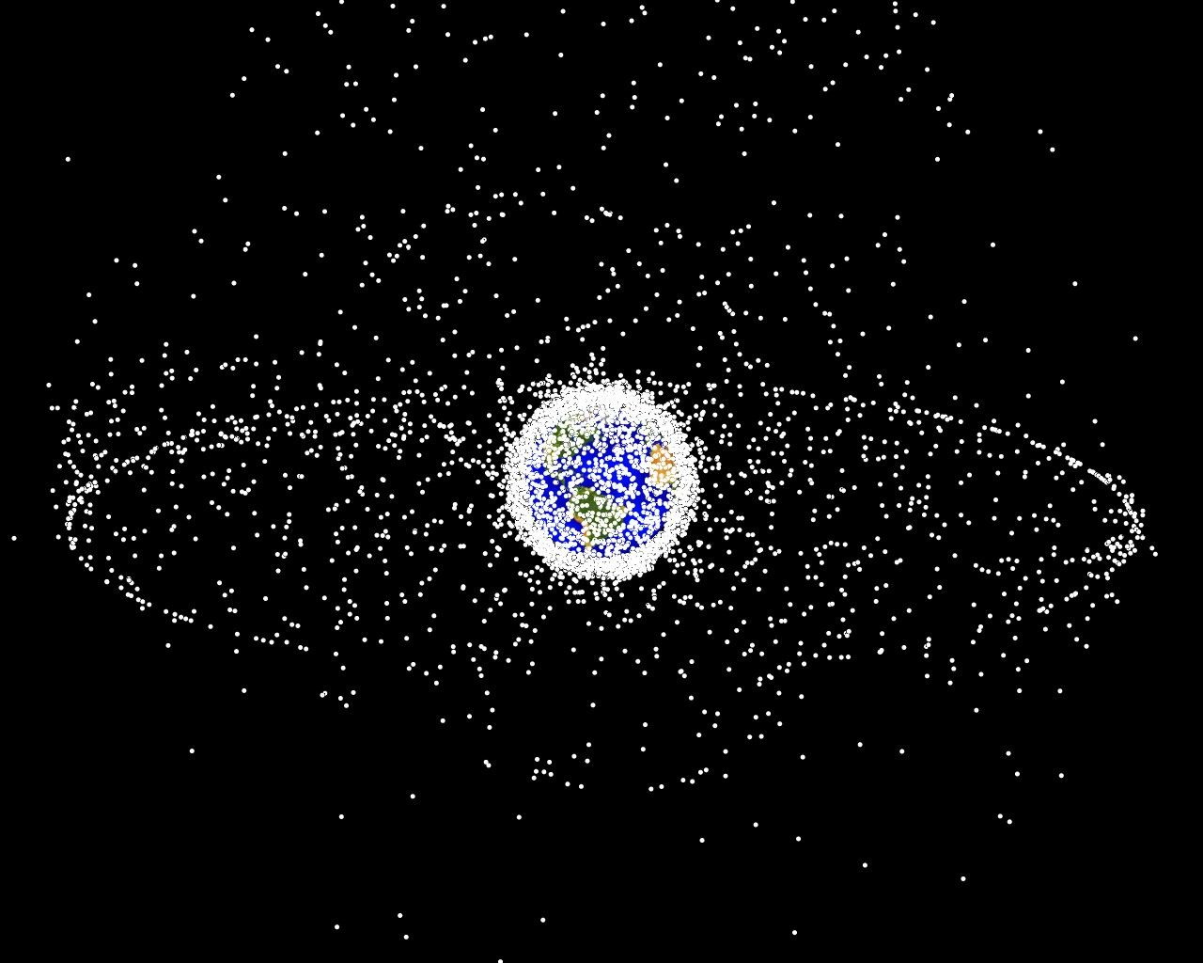
Space debris

Slide 17
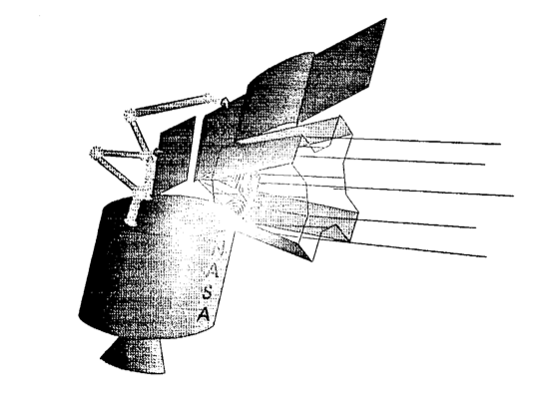
Fighting space debris

Slide 18

Space law…

Slide 19
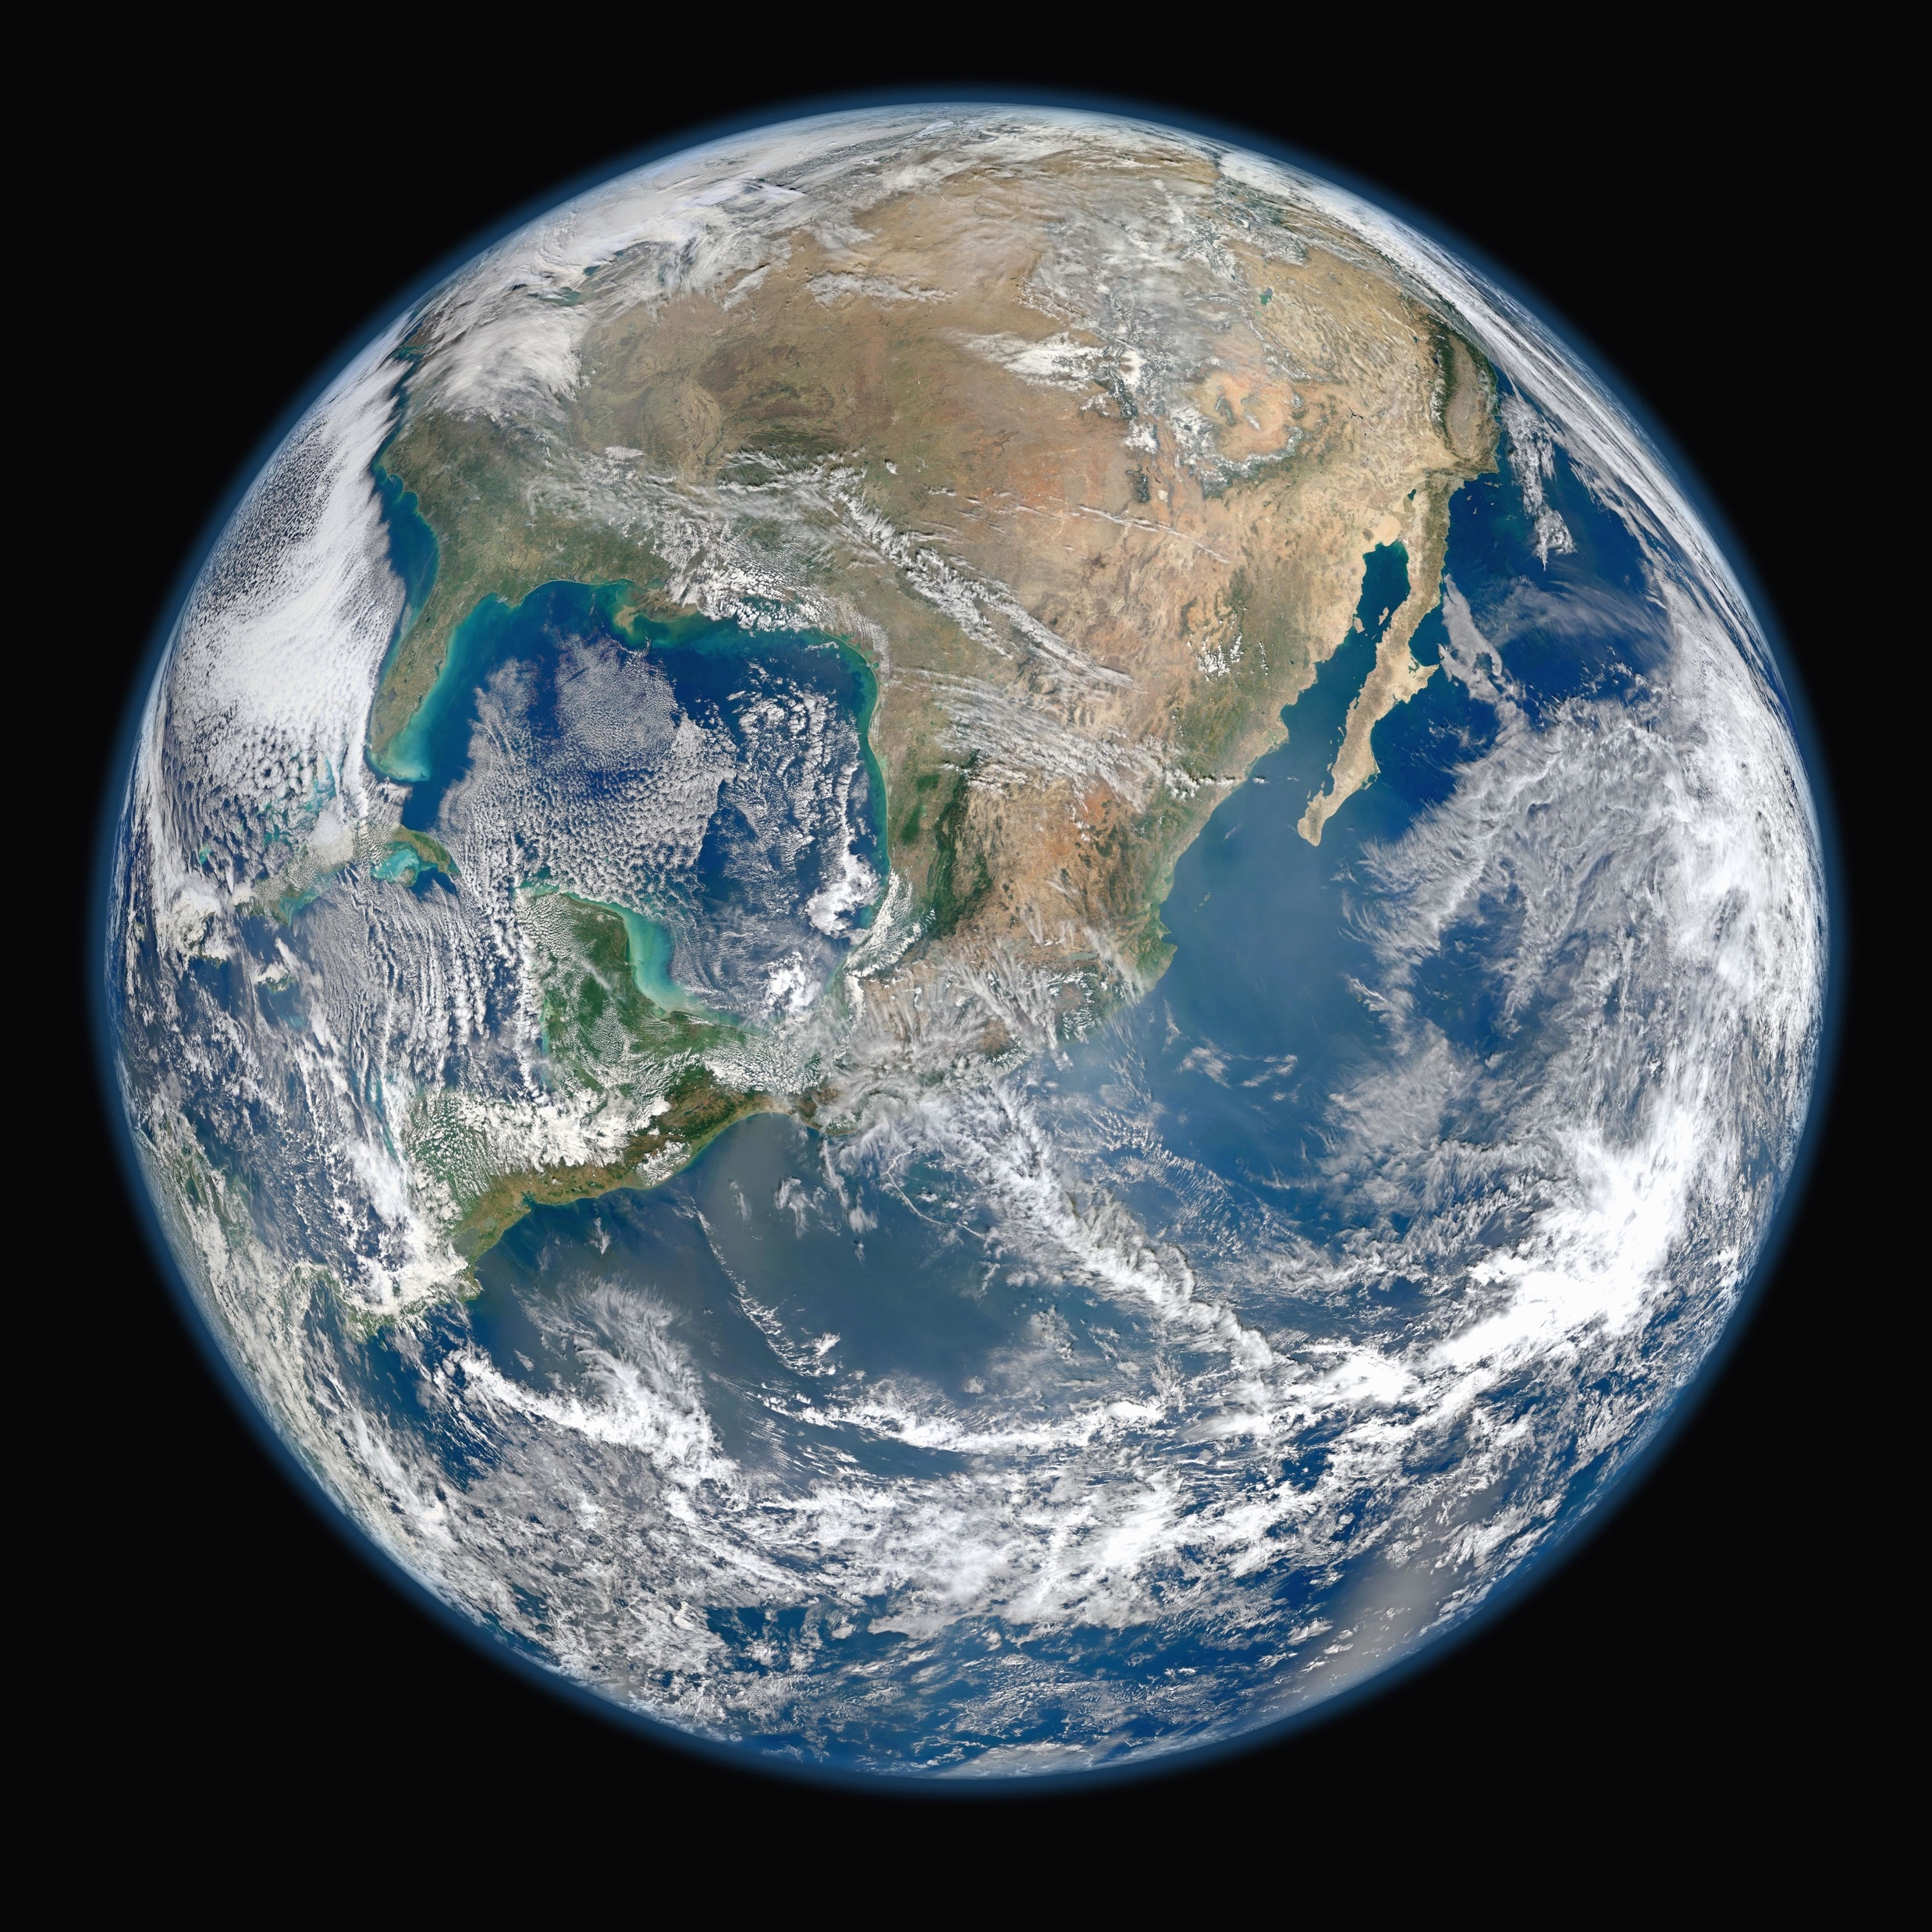

Space law in the classroom?

Slide 20
Space law tutorial!
Introducing space law: where does it come from, what does it provide, and how does that work in practice?
It will discuss:
  The most important international space treaties
  How and why national law has become important as well
  What are the key legal questions that need to be addressed
Meant for audiences with little or no legal background: jargon will be used as little as possible
Consisting of slides with spoken commentary
Contact TeachPitch if you are interested

Slide 21
Space law resources
NASA: https://www.nasa.gov
ESA: https://www.esa.int/ESA
JAXA: https://global.jaxa.jp
ISRO: https://www.isro.gov.in
CNSA: http://www.cnsa.gov.cn/english/
TEDx: https://www.youtube.com/watch?v=nhimQHsTo0s
PINC: https://mediahub.unl.edu/media/5661
TRT World: https://www.youtube.com/watch?v=6Gxhe3yZobc

Slide 22


